Slide 1
DISTRIBUTED SYSTEM INSIDE FACEBOOK DATA CENTRES
PRESENTED BY:-
Vanga Alekhya

Slide 2
Overview:
This presentation is the journey of FACEBOOK as a commercial online social network to a well established distributed data center.
Deals with the internal scenario on which Facebook developed like Hadoop and Hive in its early stages to Cloud Computing that has begun a new era in Facebook history.
Features, hardware and software , uses and are majorly discussed and also its impact on worldwide data exchange.
How technological adaptations helped in enhancement Facebook has been vividly discussed .
By the end of this presentation, a clear picture of how Facebook has become part and parcel of our lives is projected with the help of real time scenarios and technological advancements.

Slide 3
Introduction :
Found in 2004 to help world share data and stay connected with friendly relationship.
Share audio/video with friends/family and like/comment to feed that matters.
Earlier, responsible for processing large quantities of data (Big Data) like simple to huge reports and business intelligence.
Initially, Facebook is built on Hadoop and Hive systems and now Cloud Computing plays a vital role.
Shift in technologies is to enhance performance and maintain good stability and functionality.

Slide 4
Distributed System Features:
Facebook was an example of a commercial Online Social Network(OSN).
A hosted application attracting users with a set of features and for paid advertisers displaying ads targeting users.
Interconnects users through friendship and to communicate via text, multimedia(audio, video) etc., resulting in huge traffic.
Facebook is an open website published on internet as a social network system where user can easily connect by navigating the homepage .

Slide 5
Features of Facebook :
Wall :-
Original profile space for user containing posted photos and videos.
User can attach any content on to his/her wall .
Visibility of contents can be controlled by the user by constraining to specific people.
News Feed :
Homepage showing continuous updates of user’s friends list.
Explore changes in the friends list and conversations taking place between walls of user’s friends.

Slide 6
Features of Facebook:
Timeline: Space where posts are categorised according to time instant at which they are uploaded.
Friendship: Basic feature of Facebook.
Friend requests can be sent or accepted.
Full control in managing friends list.
Likes and Tags:
Positive feed back on on-going activity of friends by comments, likes and tags.
These make contents appear in friends’ notifications and updates.

Slide 7
Features of Facebook:
Notifications:
Keeps track of most recent activities.
Intimating user about the updates being added to the wall.
Networks, groups and pages:
Helps users to build online communities related to their ideas.
Allows group messaging and managing messages.
2010, new Facebook messaging service by creating an account under Facebook.com to send texts, mails etc.

Slide 8
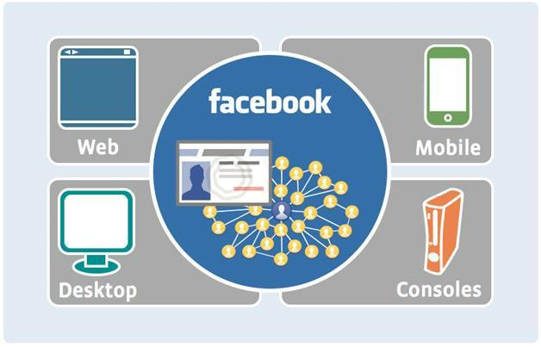
Facebook Accessibility Feature:
Any device having an access to internet can use face book.

Slide 9
Distributed System Design Architecture:
OSN relies greatly on centralized U.S. Data Centres.
Scalability, availability, openness, reliability and security are the major System requirements.
Scheme here is 3 tier architecture or more (4 tier) ,in which the data flow originated form clients requests.
Requests are served initially by dedicated webservers that are highly connected .
Then redirected in uncompressed format to the Scribe–Hadoop Clusters.
Federated Mysql - Data base engine holding up the whole system’s data bases.

Slide 10
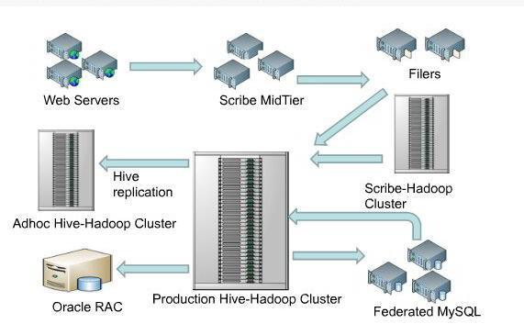
Distributed Systems’ Components:

Slide 11
Global OSN serving billions of requests and replying back in just few seconds.
Requiring scalability ability in size, geography and saving robustness of system.
Systems design, big data processing and analysis and huge Storage are the components
For their ability to holding text, multimedia and third party applications and ads and put them on the surface to the users.
Relies on Hadoop platform, best to deal with unstructured and structured data, as well as data discovery process.
Cost prohibitive is must to handle these.

Slide 12
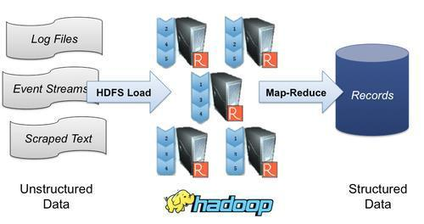
Hadoop System on Facebook:
Hadoop has Two main components: -
Map–Reduce, which dedicated for Computation. (M-R) .
Hadoop Distributed File System (HDFS), deals with Storage.

Slide 13
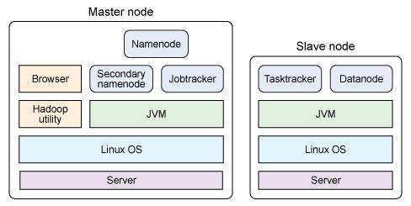
Hadoop consists of multiple master nodes to avoid single point of failure.
Job Tracker: Interacts with client applications. Distributes Map and reducing tasks to particular nodes within a cluster.
Task tracker: Receives tasks from a master node like Map and reduce it to specific cluster node and shuffle.
Name node (NN): Keeps track for each file in Hadoop Distribute File System HDFS and to locate file ,delete ,copy ,or add.
Data Node (DN): To store files in HDFS by keeping indexes, and to interact with specific NN that holds required data .
Worker Nodes: Servers for processing tasks and each worker (slave) holds DN and a task tracker.

Slide 14
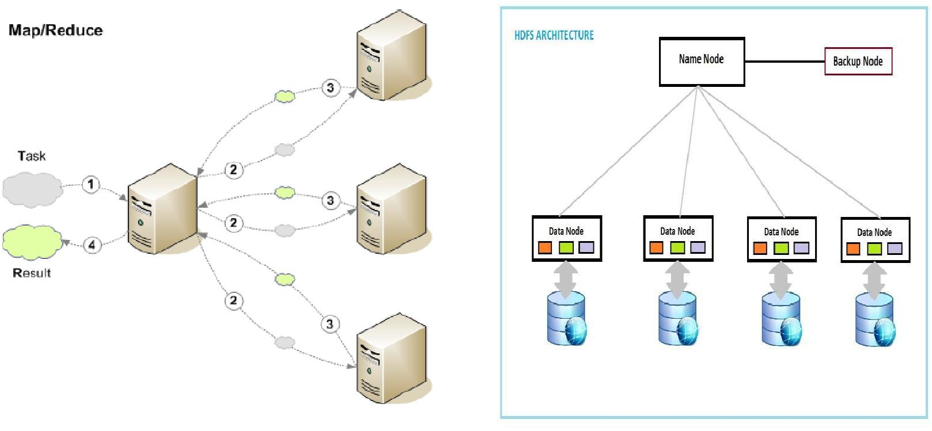
Map Reduce (MP):
Needed to handle huge data that is processed and analysed daily on Facebook.
2 major phases – Map and Reduce.

Slide 15
MR:
Uses key/value pairs to index data from HDFS and divided into blocks so as to protect system in case of failure.
M-R Job and its details given to Job tracker that contacts task tracker on each DN to schedule tasks.
Mapper process data blocks and generates a list of key value pairs.
These pairs are sorted and transferred to reducers .
M-R merge list of key value pairs generates final results and are stored in HDFS and replicated in client friendly manner.

Slide 16
Hadoop Distributed File System (HDFS)
Designed to run on low-cost hardware and being highly fault-tolerance.
Stores very large data sets reliably and is able to stream them at high bandwidth to user applications.
Used in large clusters for data storage and computation dynamically scales system stability economically.
HDFS is more for batch processing than user interaction.
Emphasizes on high throughput of data access rather than low latency.
Needs a write-once-read-many access model for files to simplify data consistency issues.

Slide 17
HFDS:
Exposes a file system namespace allowing user data to be stored in files.
File is split into one or more blocks and are stored in a set of Data Nodes(DN).
Existence of a single Name Node(NN) in a cluster greatly simplifies system’s architecture.
NN is arbitrator and repository for all HDFS
metadata.

Slide 18
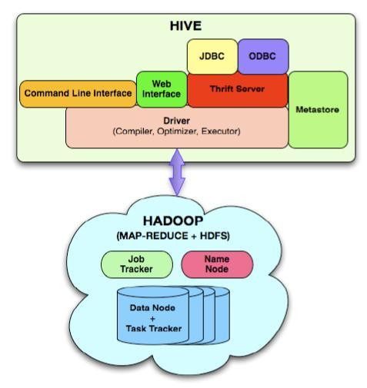
Hadoop and Hive:
A data warehouse infrastructure built
on top of Hadoop.
Provides tools for easy data
summarization and analysis, heavily
reporting , adhoc querying in HDFS.
HiveQL , query language based on SQL
used to query this data reducing time
to mere seconds.
Anyone with SQL base can work on this.

Slide 19
Apache Hbase:
Database-like layer built on Hadoop to support billions of messages.
Used for consistency, availability, partition tolerance, data model and scalability.
Being real-time ,capacity is increased with minimal overhead and no down time with strong consistency semantics and low-latency.
Unique in disaster recovery ,fault isolation
Retains atomic read –modify – write primitives .

Slide 20
Communication in General System:
Facebook adapted TCP connection oriented by posting back HTML
responses by browsers.
Various data centres have been set up across US to manage heavy traffic.(Ashburn, Santa Clara etc…)
Managing data centres is very risky and measures are to be taken.
Content Delivery Network (CDN) handles objects and co-located geographically .
TCP proxies and regional OSN caching servers will enhance network performance and reduce latency .

Slide 21
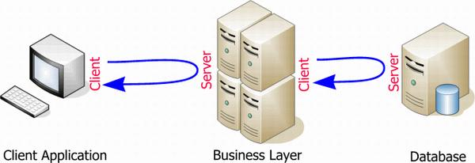
Communication in Systems Processes:
Hadoop servers compatible with Remote Procedural Call (RPC), where coming requests are redirected to MY-SQL based servers.
When a RPC client detects a tcp-socket timeout pings RPC.
While RPC is busy, client waits and then directs traffic to server.
Hadoop has ability for specifying an RPC-timeout depending on job to call data base servers than HDFS or application servers.
Threading method to maintain high write/read throughput.

Slide 22
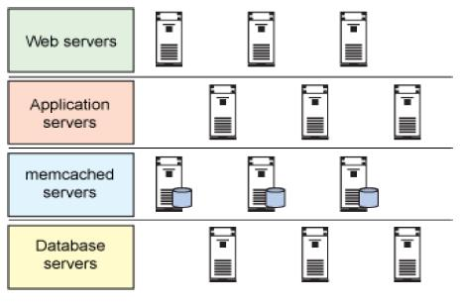
System Design Enhancement (Memcached Servers):
Hadoop and Hive together are of online jobs for efficiency and high read/write throughput.
Offline jobs to read/write large datasets to disks sequentially.
A combination of large clusters of
MySQL databases and caching tiers
built using me cached provide a
better in performance than HDFS.

Slide 23
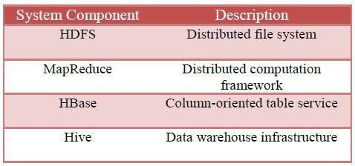
Hadoop Project Components:
MySQL storage engines provide good random read performance, but suffer from low random write throughput.
Required costly hardware and difficult to manage.

Slide 24
Cloud Computing Support:
Powerful environment to scale web applications without difficulty.
Delivers services over the network and provides ability to add capacity as needed.
Uses virtualization techniques to turn computer resources in to virtual guest computers depending on availability.
Offers accessibility to users from anywhere through their connected devices to published applications.
Basic platform for virtualization technology to meet growing demand of requests.

Slide 25
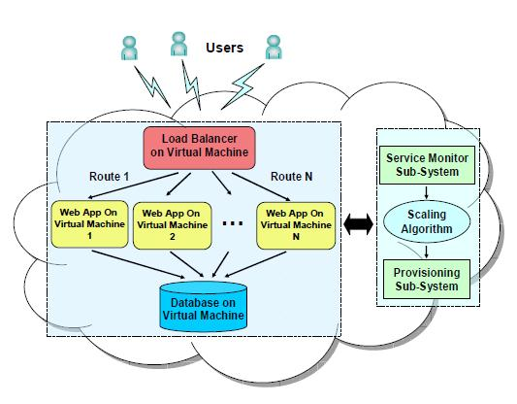
Architecture to scale Web applications in a Cloud:

Slide 26
Social Network as Virtual Organization:
A dynamic virtual organization where a trusting relationship is inherently among friends and relatives.
Social cloud offers a low level abstraction of computations and storage , building block of any social network.
Service Level Agreement (SLA) manages sharing process of virtual resources.
Cloud offers scheme of application as a service.
Cloud platforms are used to host social networks or to create such scalable applications.
Facebook plays vital role in social clouds to share information and multimedia.
Users can access storage by adhering storage agreement.

Slide 27
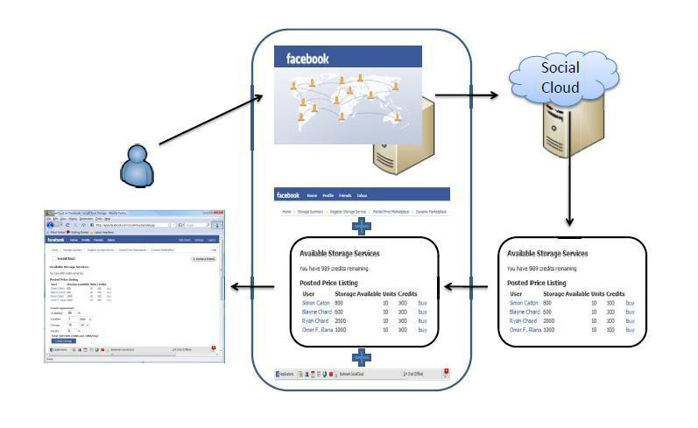
Facebook Markup Language (FML) facilitates integration between Facebook and independent host applications.
This integration is isolated so that Facebook servers are uninterrupted.
Facebook JavaScript (FBJS) are used often to request Facebook servers asynchronously in transparent manner avoiding applications servers.
Facebook application
hosting environment

Slide 28
Conclusion and Critical Evaluation:
Explored Facebook as a case study for Distributed System inside its data centre.
Discussed system features by providing a detailed design, architecture, communications and components.
Built on top of highly equipped data centers providing system availability and reliability .
Hadoop project is an example of system using clusters for database systems, load balancing webservers.
Application servers for replying on user’s requests, traffic between servers to save bandwidth and isolation between jobs.

Slide 29
Centralized data centres located in US replicated by distributed CDN, providing system level of acceptable scalability.
TCP proxies and OSN cache servers are under research that can provide required scalability.
Hadoop projects and whole components are example of success story that made Facebook to be the most popular social network of 2013.
Enhancements required to access the HDFS as fast as possible , adding RPC timeout as final one.
Memcahed severs are to decrease load accessing the data base in each case.
Cloud computing integrates users with independent host applications via virtual technology .
Virtual organizations allows on demand request to be scaled dynamically.

Slide 30
Thank you

